Slide 1
Notes:
original slide show from: https://github.com/rstudio-education/master-the-tidyverse-instructors/tree/master/powerpoints
modified 2019-10-16 by Kim Cressman to incorporate pivot() functions and shorten for CERF workshop

Slide 2
"Data are not just numbers,
they are numbers with a context."
- George Cobb and David Moore (1997)

Slide 3
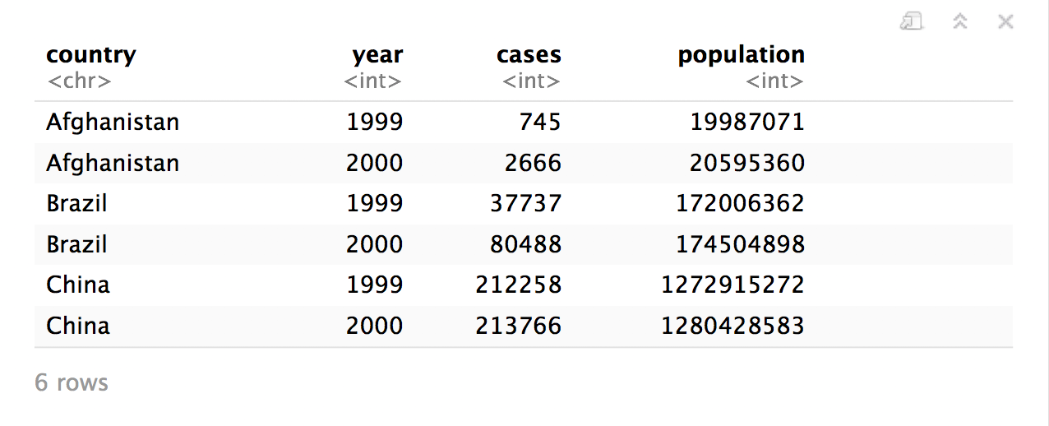
Quiz
What are the variables in this data set?
table1

Slide 4
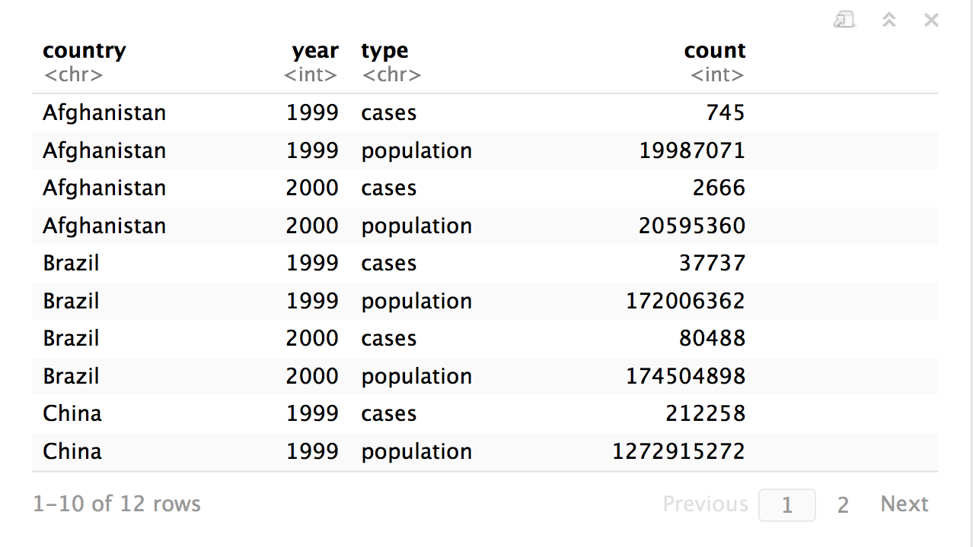
Quiz
What are the variables in this data set?
table2

Slide 5
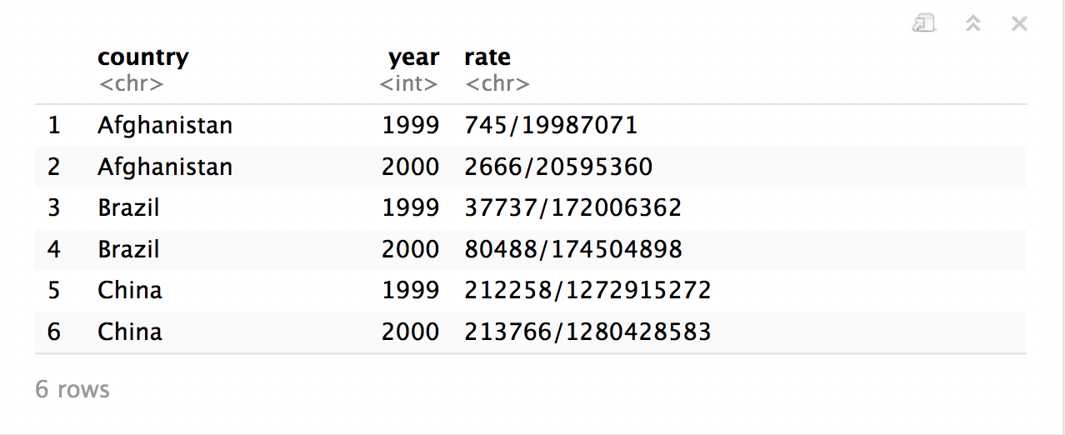

table3
CC BY-SA RStudio

Slide 6
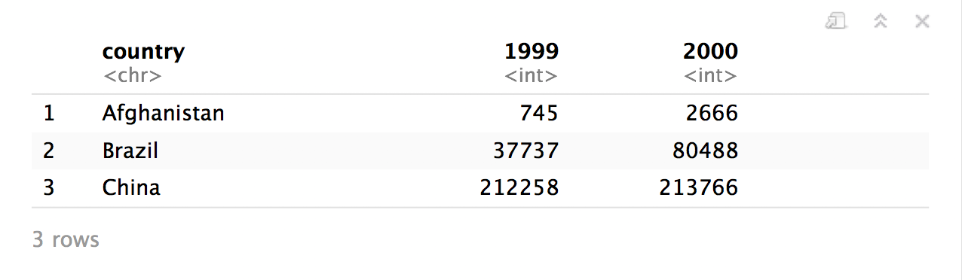
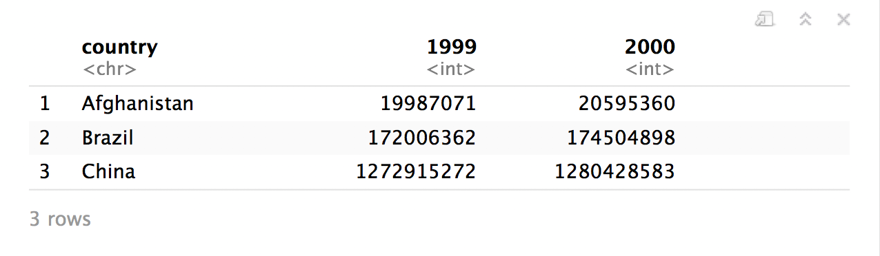
table4a
table4b
CC BY-SA RStudio

Slide 7
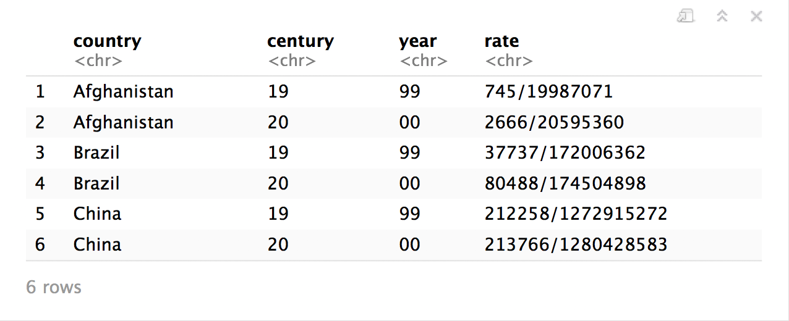
table5
CC BY-SA RStudio

Slide 8
"Data comes in many formats, but R prefers just one: tidy data. "
- Garrett Grolemund

Slide 9
Tidy data
country | year | cases | pop
Afghanistan | 1999 | 745 | 19987071
Afghanistan | 2000 | 2666 | 20595360
Brazil | 1999 | 37737 | 172006362
Brazil | 2000 | 80488 | 174504898
China | 1999 | 212258 | 1272915272
China | 2000 | 213766 | 1280428583
A data set is tidy iff:
Each variable is in its own column
Each case is in its own row
Each value is in its own cell

Slide 10
table1$country
table1$year
table1$cases
table1$population

Slide 11


table2$country
table2$year
table2$count[c(1,3,5,7,9,11)]
table2$count[c(2,4,6,8,10,12)]

Slide 12
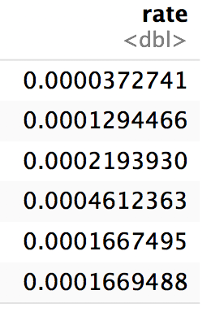
table1$cases / table1$population -> table1$rate

Slide 13
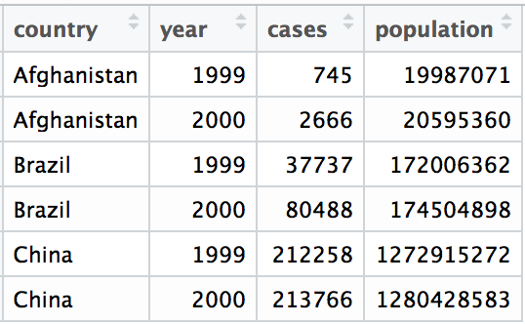
Tidy data
A data set is tidy iff:
Each variable is in its own column
Each case is in its own row
Each value is in its own cell

Slide 14
Import data into software
Collect
Data
Tidy data into useable form
Design Experiment
Explore or Test
Form Hypothesis
Transform the data. Do feature engineering.
Deploy app or publish paper
Write code to apply a modeling algorithm.
Build app or write paper
Visualize the data and/or results
Communicate Results

Slide 15
Tidy data into useable form
Import data into software
Munge data
Collect
Data
Explore or Test
Design Experiment
Transform the data. Do feature engineering.
Form Hypothesis
Munge data
Deploy app or publish paper
Write code to apply a modeling algorithm.
Build app or write paper
Munge data
Communicate Results
Visualize the data and/or results
Munge data

Slide 16
Tidy data
Tidy functions all expect and return the same data structure, known as tidy data:
A data frame that contains
variables in the columns and
cases in the rows.

Slide 17
"Tidy data sets are all alike; but every messy data set is messy in its own way."
- Hadley Wickham

Slide 18

tidyr

Slide 19
tidyr
A package that reshapes the layout of tabular data.
CC BY-SA RStudio

Slide 20
pivot_longer()

Slide 21
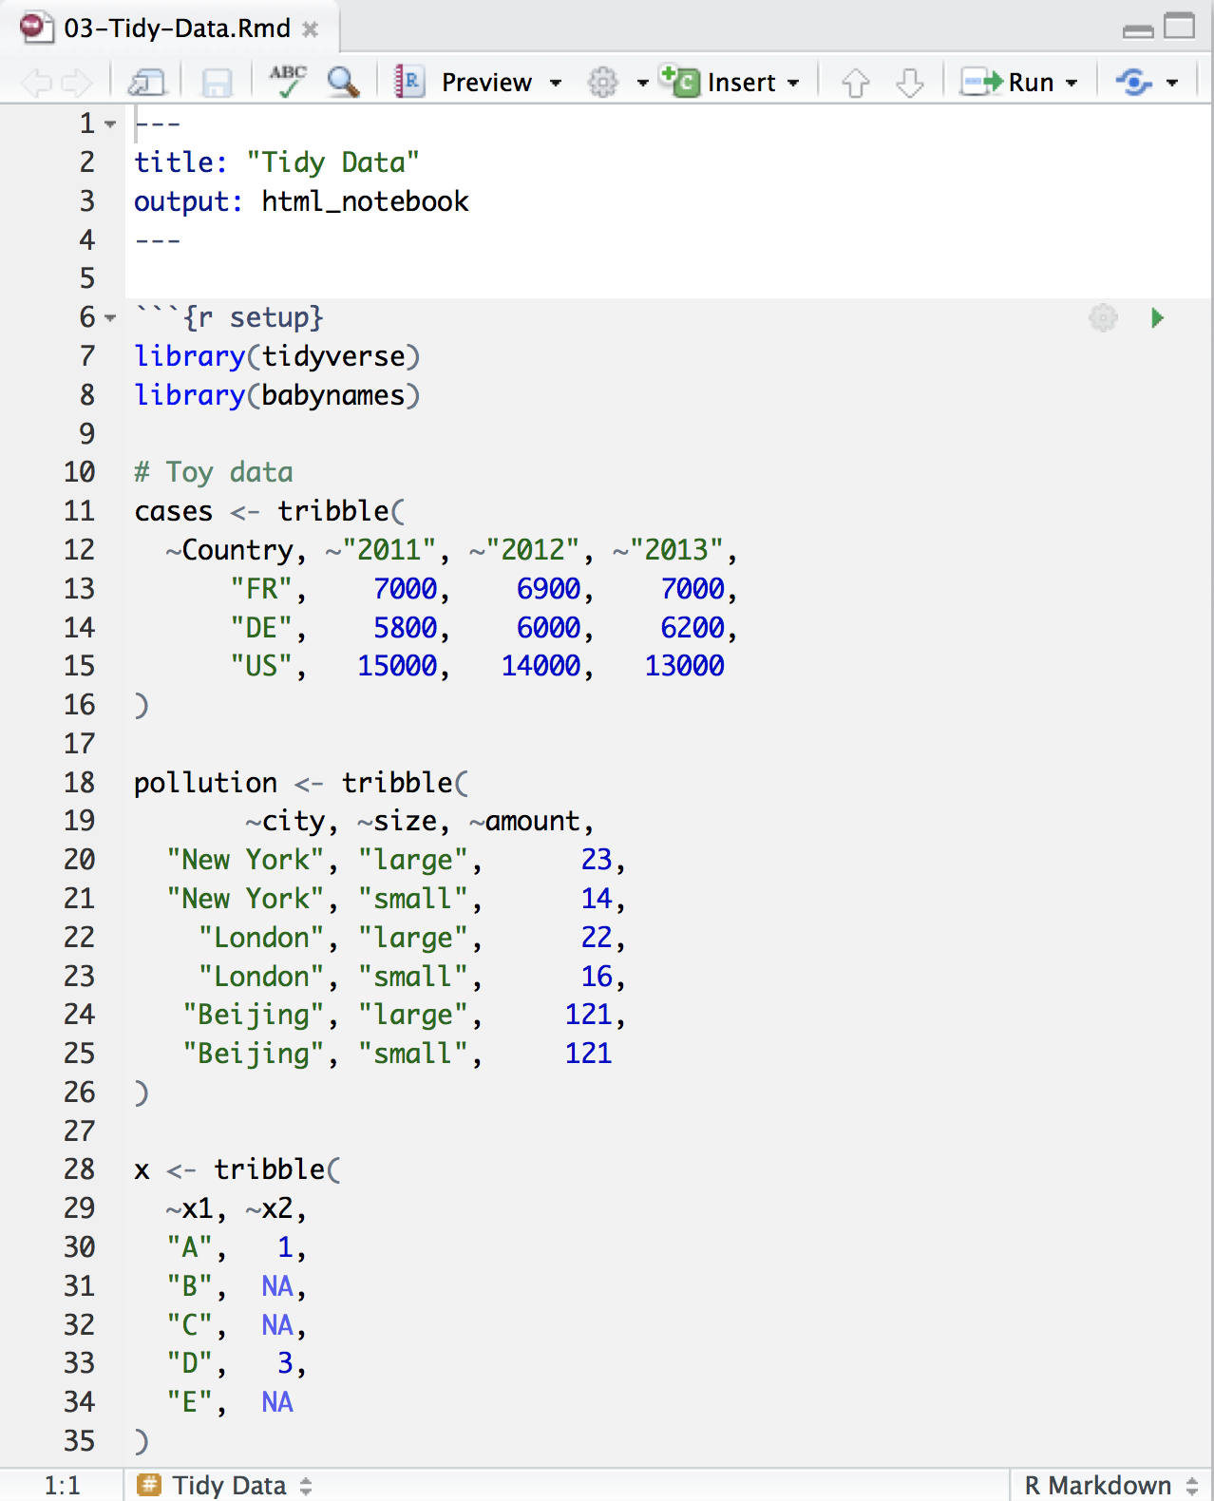
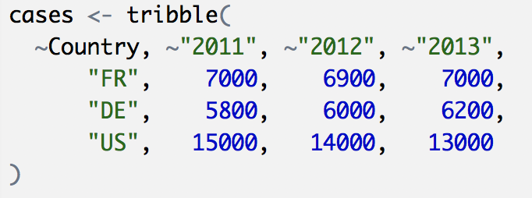
Toy data
CC BY-SA RStudio

Slide 22
Quiz
What are the variables in cases?
Country | 2011 | 2012 | 2013
FR | 7000 | 6900 | 7000
DE | 5800 | 6000 | 6200
US | 15000 | 14000 | 13000

Slide 23
Quiz
What are the variables in cases?
Country | 2011 | 2012 | 2013
FR | 7000 | 6900 | 7000
DE | 5800 | 6000 | 6200
US | 15000 | 14000 | 13000
Country
Year
Count

Slide 24
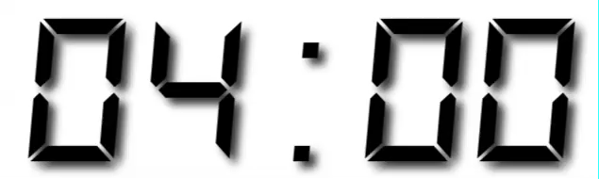
Your Turn 1
On a sheet of paper, draw how the cases data set would look if it had the same values grouped into three columns: country, year, n
Country | 2011 | 2012 | 2013
FR | 7000 | 6900 | 7000
DE | 5800 | 6000 | 6200
US | 15000 | 14000 | 13000

Slide 25
Country | 2011 | 2012 | 2013
FR | 7000 | 6900 | 7000
DE | 5800 | 6000 | 6200
US | 15000 | 14000 | 13000
CC BY-SA RStudio

Slide 26
Country | 2011 | 2012 | 2013
FR | 7000 | 6900 | 7000
DE | 5800 | 6000 | 6200
US | 15000 | 14000 | 13000
Country | Year | n
FR | 2011 | 7000
DE | 2011 | 5800
US | 2011 | 15000
FR | 2012 | 6900
DE | 2012 | 6000
US | 2012 | 14000
FR | 2013 | 7000
DE | 2013 | 6200
US | 2013 | 13000
CC BY-SA RStudio

Slide 27
Country | 2011 | 2012 | 2013
FR | 7000 | 6900 | 7000
DE | 5800 | 6000 | 6200
US | 15000 | 14000 | 13000
Country | Year | n
FR | 2011 | 7000
DE | 2011 | 5800
US | 2011 | 15000
FR | 2012 | 6900
DE | 2012 | 6000
US | 2012 | 14000
FR | 2013 | 7000
DE | 2013 | 6200
US | 2013 | 13000
CC BY-SA RStudio

Slide 28
Country | 2011 | 2012 | 2013
FR | 7000 | 6900 | 7000
DE | 5800 | 6000 | 6200
US | 15000 | 14000 | 13000
Country | Year | n
FR | 2011 | 7000
DE | 2011 | 5800
US | 2011 | 15000
FR | 2012 | 6900
DE | 2012 | 6000
US | 2012 | 14000
FR | 2013 | 7000
DE | 2013 | 6200
US | 2013 | 13000
CC BY-SA RStudio

Slide 29
Country | 2011 | 2012 | 2013
FR | 7000 | 6900 | 7000
DE | 5800 | 6000 | 6200
US | 15000 | 14000 | 13000
Country | Year | n
FR | 2011 | 7000
DE | 2011 | 5800
US | 2011 | 15000
FR | 2012 | 6900
DE | 2012 | 6000
US | 2012 | 14000
FR | 2013 | 7000
DE | 2013 | 6200
US | 2013 | 13000
CC BY-SA RStudio

Slide 30
Country | 2011 | 2012 | 2013
FR | 7000 | 6900 | 7000
DE | 5800 | 6000 | 6200
US | 15000 | 14000 | 13000
Country | Year | n
FR | 2011 | 7000
DE | 2011 | 5800
US | 2011 | 15000
FR | 2012 | 6900
DE | 2012 | 6000
US | 2012 | 14000
FR | 2013 | 7000
DE | 2013 | 6200
US | 2013 | 13000
CC BY-SA RStudio

Slide 31
Country | 2011 | 2012 | 2013
FR | 7000 | 6900 | 7000
DE | 5800 | 6000 | 6200
US | 15000 | 14000 | 13000
Country | Year | n
FR | 2011 | 7000
DE | 2011 | 5800
US | 2011 | 15000
FR | 2012 | 6900
DE | 2012 | 6000
US | 2012 | 14000
FR | 2013 | 7000
DE | 2013 | 6200
US | 2013 | 13000
CC BY-SA RStudio

Slide 32
Country | 2011 | 2012 | 2013
FR | 7000 | 6900 | 7000
DE | 5800 | 6000 | 6200
US | 15000 | 14000 | 13000
Country | Year | n
FR | 2011 | 7000
DE | 2011 | 5800
US | 2011 | 15000
FR | 2012 | 6900
DE | 2012 | 6000
US | 2012 | 14000
FR | 2013 | 7000
DE | 2013 | 6200
US | 2013 | 13000
CC BY-SA RStudio

Slide 33
Country | 2011 | 2012 | 2013
FR | 7000 | 6900 | 7000
DE | 5800 | 6000 | 6200
US | 15000 | 14000 | 13000
Country | Year | n
FR | 2011 | 7000
DE | 2011 | 5800
US | 2011 | 15000
FR | 2012 | 6900
DE | 2012 | 6000
US | 2012 | 14000
FR | 2013 | 7000
DE | 2013 | 6200
US | 2013 | 13000
CC BY-SA RStudio

Slide 34
Country | 2011 | 2012 | 2013
FR | 7000 | 6900 | 7000
DE | 5800 | 6000 | 6200
US | 15000 | 14000 | 13000
Country | Year | n
FR | 2011 | 7000
DE | 2011 | 5800
US | 2011 | 15000
FR | 2012 | 6900
DE | 2012 | 6000
US | 2012 | 14000
FR | 2013 | 7000
DE | 2013 | 6200
US | 2013 | 13000
CC BY-SA RStudio

Slide 35
Country | 2011 | 2012 | 2013
FR | 7000 | 6900 | 7000
DE | 5800 | 6000 | 6200
US | 15000 | 14000 | 13000
Country | Year | n
FR | 2011 | 7000
DE | 2011 | 5800
US | 2011 | 15000
FR | 2012 | 6900
DE | 2012 | 6000
US | 2012 | 14000
FR | 2013 | 7000
DE | 2013 | 6200
US | 2013 | 13000
CC BY-SA RStudio

Slide 36
Country | 2011 | 2012 | 2013
FR | 7000 | 6900 | 7000
DE | 5800 | 6000 | 6200
US | 15000 | 14000 | 13000
Country | Year | n
FR | 2011 | 7000
DE | 2011 | 5800
US | 2011 | 15000
FR | 2012 | 6900
DE | 2012 | 6000
US | 2012 | 14000
FR | 2013 | 7000
DE | 2013 | 6200
US | 2013 | 13000
CC BY-SA RStudio

Slide 37
Country | 2011 | 2012 | 2013
FR | 7000 | 6900 | 7000
DE | 5800 | 6000 | 6200
US | 15000 | 14000 | 13000
Country | Year | n
FR | 2011 | 7000
DE | 2011 | 5800
US | 2011 | 15000
FR | 2012 | 6900
DE | 2012 | 6000
US | 2012 | 14000
FR | 2013 | 7000
DE | 2013 | 6200
US | 2013 | 13000
pivot_longer()
CC BY-SA RStudio

Slide 38
1
2
Country | 2011 | 2012 | 2013
FR | 7000 | 6900 | 7000
DE | 5800 | 6000 | 6200
US | 15000 | 14000 | 13000
Country | Year | n
FR | 2011 | 7000
DE | 2011 | 5800
US | 2011 | 15000
FR | 2012 | 6900
DE | 2012 | 6000
US | 2012 | 14000
FR | 2013 | 7000
DE | 2013 | 6200
US | 2013 | 13000
CC BY-SA RStudio

Slide 39
names_to (former column names)
Country | 2011 | 2012 | 2013
FR | 7000 | 6900 | 7000
DE | 5800 | 6000 | 6200
US | 15000 | 14000 | 13000
Country | Year | n
FR | 2011 | 7000
DE | 2011 | 5800
US | 2011 | 15000
FR | 2012 | 6900
DE | 2012 | 6000
US | 2012 | 14000
FR | 2013 | 7000
DE | 2013 | 6200
US | 2013 | 13000
CC BY-SA RStudio

Slide 40
values_to (former cells)
Country | 2011 | 2012 | 2013
FR | 7000 | 6900 | 7000
DE | 5800 | 6000 | 6200
US | 15000 | 14000 | 13000
Country | Year | n
FR | 2011 | 7000
DE | 2011 | 5800
US | 2011 | 15000
FR | 2012 | 6900
DE | 2012 | 6000
US | 2012 | 14000
FR | 2013 | 7000
DE | 2013 | 6200
US | 2013 | 13000
CC BY-SA RStudio

Slide 41
pivot_longer()
cases %>% pivot_longer(cols = 2:4, names_to = "year", values_to = "n")
data frame to reshape
numeric indices of columns to collapse
(or names)
name of the new key column
(a character string)
name of the new value column
(a character string)

Slide 42
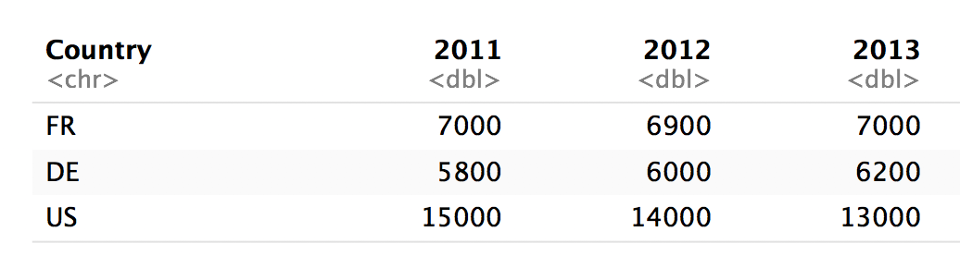
pivot_longer()
cases %>% pivot_longer(2:4, "year", "n")
numeric indices
2
3
4

Slide 43
pivot_longer()
cases %>% pivot_longer(c("2011", "2012", "2013"), "year", "n")
names
2011
2012
2013

Slide 44
pivot_longer()
cases %>% pivot_longer(-Country, "year","n")
Everything except…
Not Country
Not Country
Not Country

Slide 45
pivot_longer()
cases %>% pivot_longer(2:4, "year", "n")
cases %>% pivot_longer(c("2011", "2012", "2013"), "year", "n")
cases %>% pivot_longer(starts_with("201"), "year", "n")
cases %>% pivot_longer(-Country, "year","n")

Slide 46
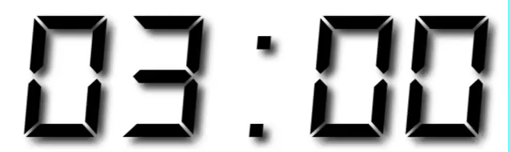
Your Turn 2
Use pivot_longer() to reorganize table4a into three columns: country, year, and cases.
Notes:
table4a is a built-in dataset

Slide 47
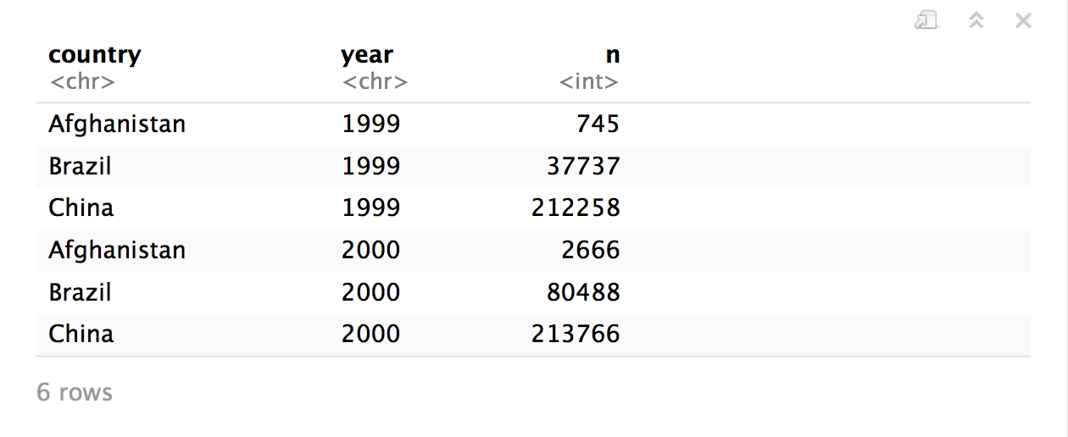
table4a %>%
pivot_longer(cols = 2:3, names_to = "year", values_to = "n")

Slide 48
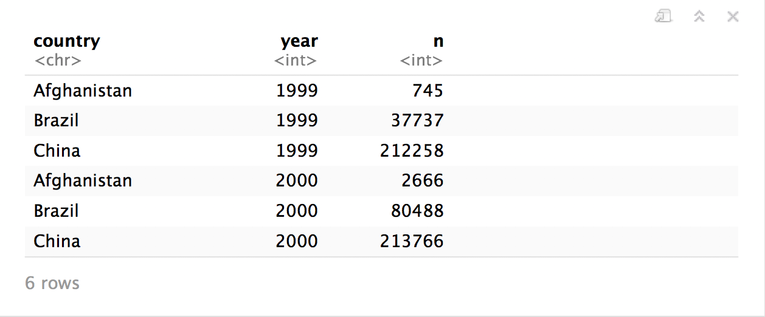
table4a %>%
pivot_longer(cols = 2:3, names_to = "year", values_to = "n",
names_ptypes = list(year = integer()))

Slide 49
pivot_wider()

Slide 50
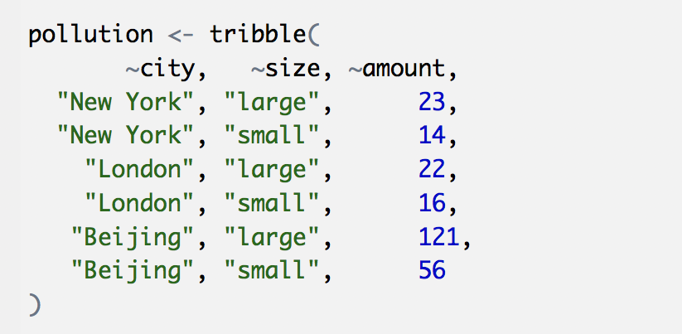
Toy data
CC BY-SA RStudio

Slide 51
Quiz
What are the variables in pollution?
city | particle size | amount (µg/m³)
New York | large | 23
New York | small | 14
London | large | 22
London | small | 16
Beijing | large | 121
Beijing | small | 56

Slide 52

Quiz
What are the variables in pollution?
city | particle size | amount (µg/m³)
New York | large | 23
New York | small | 14
London | large | 22
London | small | 16
Beijing | large | 121
Beijing | small | 56
City
Amount of large particulate
Amount of small particulate

Slide 53
Your Turn 3
On a sheet of paper, draw how this data set would look if it had the same values grouped into three columns: city, large, small
city | size | amount
New York | large | 23
New York | small | 14
London | large | 22
London | small | 16
Beijing | large | 121
Beijing | small | 56

Slide 54
city | size | amount
New York | large | 23
New York | small | 14
London | large | 22
London | small | 16
Beijing | large | 121
Beijing | small | 56
CC BY-SA RStudio

Slide 55
city | size | amount
New York | large | 23
New York | small | 14
London | large | 22
London | small | 16
Beijing | large | 121
Beijing | small | 56
city | large | small
New York | 23 | 14
London | 22 | 16
Beijing | 121 | 56
CC BY-SA RStudio

Slide 56
city | size | amount
New York | large | 23
New York | small | 14
London | large | 22
London | small | 16
Beijing | large | 121
Beijing | small | 56
city | large | small
New York | 23 | 14
London | 22 | 16
Beijing | 121 | 56
CC BY-SA RStudio

Slide 57
city | size | amount
New York | large | 23
New York | small | 14
London | large | 22
London | small | 16
Beijing | large | 121
Beijing | small | 56
city | large | small
New York | 23 | 14
London | 22 | 16
Beijing | 121 | 56
CC BY-SA RStudio

Slide 58
city | size | amount
New York | large | 23
New York | small | 14
London | large | 22
London | small | 16
Beijing | large | 121
Beijing | small | 56
city | large | small
New York | 23 | 14
London | 22 | 16
Beijing | 121 | 56
CC BY-SA RStudio

Slide 59
city | size | amount
New York | large | 23
New York | small | 14
London | large | 22
London | small | 16
Beijing | large | 121
Beijing | small | 56
city | large | small
New York | 23 | 14
London | 22 | 16
Beijing | 121 | 56
CC BY-SA RStudio

Slide 60
city | size | amount
New York | large | 23
New York | small | 14
London | large | 22
London | small | 16
Beijing | large | 121
Beijing | small | 56
city | large | small
New York | 23 | 14
London | 22 | 16
Beijing | 121 | 56
CC BY-SA RStudio

Slide 61
city | size | amount
New York | large | 23
New York | small | 14
London | large | 22
London | small | 16
Beijing | large | 121
Beijing | small | 56
city | large | small
New York | 23 | 14
London | 22 | 16
Beijing | 121 | 56
CC BY-SA RStudio

Slide 62
city | size | amount
New York | large | 23
New York | small | 14
London | large | 22
London | small | 16
Beijing | large | 121
Beijing | small | 56
city | large | small
New York | 23 | 14
London | 22 | 16
Beijing | 121 | 56
CC BY-SA RStudio

Slide 63
city | size | amount
New York | large | 23
New York | small | 14
London | large | 22
London | small | 16
Beijing | large | 121
Beijing | small | 56
pivot_wider()
city | large | small
New York | 23 | 14
London | 22 | 16
Beijing | 121 | 56
CC BY-SA RStudio

Slide 64
1
2
city | size | amount
New York | large | 23
New York | small | 14
London | large | 22
London | small | 16
Beijing | large | 121
Beijing | small | 56
city | large | small
New York | 23 | 14
London | 22 | 16
Beijing | 121 | 56
CC BY-SA RStudio

Slide 65
names_from (new column names)
city | size | amount
New York | large | 23
New York | small | 14
London | large | 22
London | small | 16
Beijing | large | 121
Beijing | small | 56
city | large | small
New York | 23 | 14
London | 22 | 16
Beijing | 121 | 56
CC BY-SA RStudio

Slide 66
values_from (new cells)
city | size | amount
New York | large | 23
New York | small | 14
London | large | 22
London | small | 16
Beijing | large | 121
Beijing | small | 56
city | large | small
New York | 23 | 14
London | 22 | 16
Beijing | 121 | 56
CC BY-SA RStudio

Slide 67
pivot_wider()
pollution %>% pivot_wider(names_from = size, values_from = amount)
data frame to reshape
column to use for keys (becomes new
column names)
column to use for values
(becomes new
column cells)

Slide 68
pollution %>% pivot_wider(names_from = size, values_from = amount)
city | size | amount
New York | large | 23
New York | small | 14
London | large | 22
London | small | 16
Beijing | large | 121
Beijing | small | 56
city | large | small
New York | 23 | 14
London | 22 | 16
Beijing | 121 | 56
CC BY-SA RStudio

Slide 69
Your Turn 4
Use pivot_wider() to reorganize table2 into four columns: country, year, cases, and population.

Slide 70
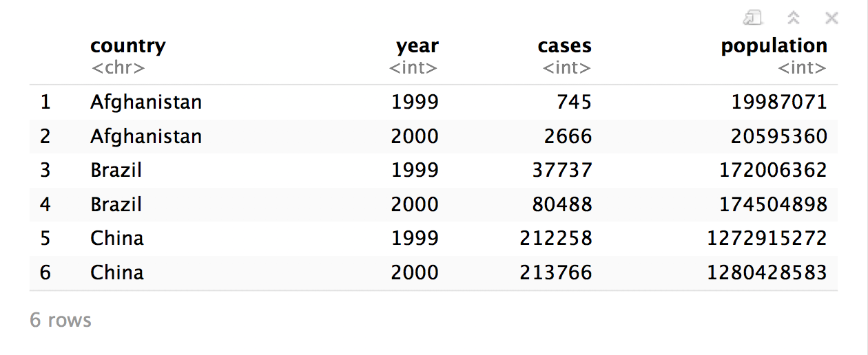
table2 %>%
pivot_wider(names_from = type, values_from = count)

Slide 72
Reshaping
Final Exam

Slide 73
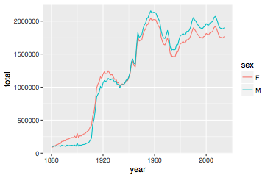
Number of children by year and gender
CC BY-SA RStudio

Slide 74
Can we calculate the ratio of boys to girls?
babynames %>%
group_by(year, sex) %>%
summarise(n = sum(n))
year sex n
<dbl> <chr> <int>
1 1880 F 90993
2 1880 M 110491
3 1881 F 91954
4 1881 M 100745
5 1882 F 107850
6 1882 M 113688
7 1883 F 112321
8 1883 M 104629
9 1884 F 129022
10 1884 M 114445
# ... with 260 more rows
CC BY-SA RStudio

Slide 75
Can we calculate the ratio of boys to girls?
babynames %>%
group_by(year, sex) %>%
summarise(n = sum(n))
year sex n
<dbl> <chr> <int>
1 1880 F 90993
2 1880 M 110491
3 1881 F 91954
4 1881 M 100745
5 1882 F 107850
6 1882 M 113688
7 1883 F 112321
8 1883 M 104629
9 1884 F 129022
10 1884 M 114445
# ... with 260 more rows
Now what?
CC BY-SA RStudio

Slide 76
Can we calculate the ratio of boys to girls?
better_layout %>%
mutate(percent_male = M / (M + F) * 100)
year sex n
<dbl> <chr> <int>
1 1880 F 90993
2 1880 M 110491
3 1881 F 91954
4 1881 M 100745
5 1882 F 107850
6 1882 M 113688
7 1883 F 112321
8 1883 M 104629
9 1884 F 129022
10 1884 M 114445
# ... with 260 more rows
year F M
* <dbl> <int> <int>
1 1880 90993 110491
2 1881 91954 100745
3 1882 107850 113688
4 1883 112321 104629
5 1884 129022 114445
6 1885 133055 107800
7 1886 144535 110784
8 1887 145982 101414
9 1888 178627 120853
10 1889 178366 110584
?
CC BY-SA RStudio

Slide 77
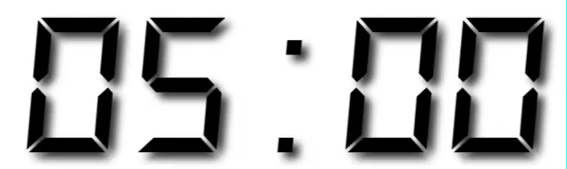
Your Turn 7
Reshape the layout of this data. Calculate the percent of male (or female) children by year. Then plot the percent over time.
babynames %>%
group_by(year, sex) %>%
summarise(n = sum(n))

Slide 78
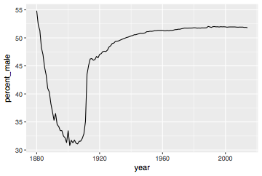
babynames %>%
group_by(year, sex) %>%
summarise(n = sum(n)) %>%
spread(sex, n) %>%
mutate(percent_male = M / (M + F) * 100) %>%
ggplot(aes(year, percent_male)) + geom_line()
CC BY-SA RStudio

Slide 79
Percent of children that are male by year
CC BY-SA RStudio

Slide 80
Section

Slide 81
Code
HTTP Verb
HTTP version
URL path
URL path
GET /resources/webinars/ HTTP/1.1
Host: www.rstudio.com
User-Agent: libcurl/7.43.0 r-curl/2.1 httr/1.2.1
Accept-Encoding: gzip, deflate
Accept: application/json, text/xml, application/xml, */*
CC BY-SA RStudio

Slide 82
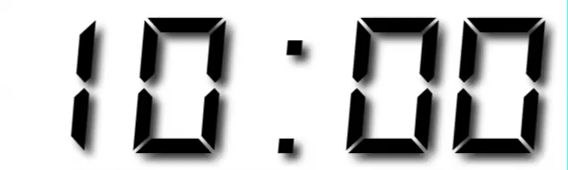
Your Turn
Open R. Then download the packages that we will use today by running the following code.

Slide 83
Sub section

Slide 84
CC BY-SA RStudio

Slide 85









Technical Diagram
Shiny Server Pro
Production
Data Scientists
RStudio IDE
End Users
Web Browsers
Sticky Load Balancer
Staging
Data Stores
File Share
Data Mart

Slide 86





















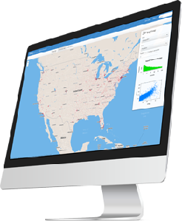
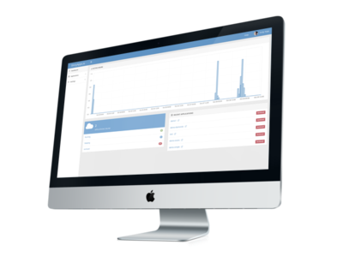



















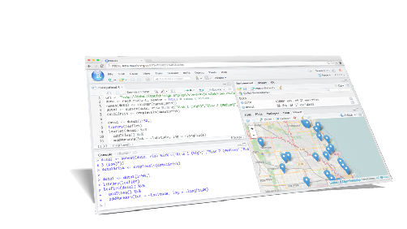
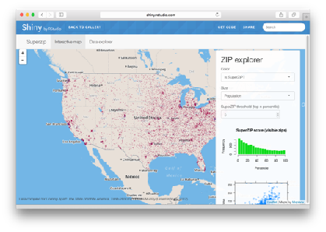






Icons
Hardware
Software
Packages
Architecture
dplyr
0.4
+
SYSTEM LIBRARY

Slide 87


Hardware
Software
Packages
Architecture

rvest

